Slide 1
…

Slide 2

Auditorium
The Growth and Development of the New Testament Church
Eastside Curriculum – Qtr 14 (Nov. 2025 – Jan. 2026)

Slide 3
1)
2)
3)
4)
5)
6)
7)
8)
9)
10)
11)
12)
13)
14)
15)
Ascension & Appointment
Philippian Prison
16)
17)
18)
19)
20)
21)
22)
23)
24)
25)
26)
27)
28)
Pentecost & Peter’s Preaching
Addressing Athens
Lame Man & Lesson
Achaia, Antioch, & Apollos
Restrained, Released, & Request
Re-baptism, Repentance, & Riot
Deception & Detention
Macedonia & Miletus
Seven Selected
Jerusalem & Jewish Mob
Stephen Stoned
Review & Rejection
Samaria & Salvation
Council & Conspiracy
Saul Saved & Dorcas Delivered
Caesarean Confinement
Cornelius Converted
Appeal & Agrippa
Report & Relief
A
Review & Ridicule
Persecution, Peter, & Pride
Marooned On Malta
CTS
Antioch to Iconium
F
Rescued To Rome
Iconium to Antioch
ACTS
Disagreement & Decision
Alliteration Memory Statements To Help Recall Chapter Content
Notes:
Reference the Alliteration memory statements available for individual study of Acts and a means of helping each of us better study the book of Acts

Slide 4
Paul Begins The 3rd Journey In Galatia & Phrygia 18:23
After spending some time in Antioch, Paul departs on his 3rd journey… he travels the same territory he visited on his first 2 journeys
No doubt, this would have included churches previously planted in Derbe, Lystra, Iconium, and Antioch (Pisidia)
– How good it must have been for those brethren to see Paul again, and for him to be with & strengthen them!!
Some general time-line data to consider:
– 1st journey was approx. A.D. 44/45 to A.D. 48/49 (Acts 13-14)
– 2nd journey was approx. A.D. 50-51 to A.D. 52-53 (Acts 15-18)
– 3rd journey begins approx. A.D. 53/54 to A.D. 58-59 (Acts 18-21)

Slide 5
Apollos At Ephesus 18:24-26
His description vv. 24-25
A Jew born in Alexandria (Egypt)
An eloquent man [logios]
– “Learned; a man of letters, skilled in literature & the arts, esp. versed in history and antiquities; skilled in speech” [Thayer, pp. 379-380]
– Remember, the Septuagint was translated in Alexandria in 200 B.C.
– Not an apostle “led (guided) into all truth” Jn 16:13
Mighty in the Scriptures excelling in knowledge
Instructed in the way of the Lord
Fervent in spirit on fire; to boil with heat; to be zealous

Slide 6
Apollos At Ephesus 18:24-26
His description vv. 24-25
Instructed in the way of the Lord
Spoke accurately the things concerning Jesus
BUT…still misinformed only acquainted with the baptism of John
His efforts in the synagogue v. 26
He needed assistance as he was publicly teaching boldly
Fortunately, Paul had left Aquila & Priscilla in Ephesus v. 19
They took him aside and “…explained to him the way of God more accurately”

Slide 7
Apollos At Corinth 18:27-28
He wanted to cross over to Corinth v. 27a
The brethren encouraged him to that work…they wrote a letter to the Corinthian church to welcome him v. 27b
Ephesus having “brethren” is largely attributable to Aquila & Priscilla… remember, Paul had not stayed long on his previous visit vv. 20-21
His work in Corinth vv. 27c-28
He “helped greatly” those who had believed through grace
He “powerfully refuted” the Jews publicly, demonstrating from the Scriptures that Jesus is the Christ (Messiah)
This must have been Paul’s later reference re: Apollos 1 Cor 3:1-6 4:6

Slide 8
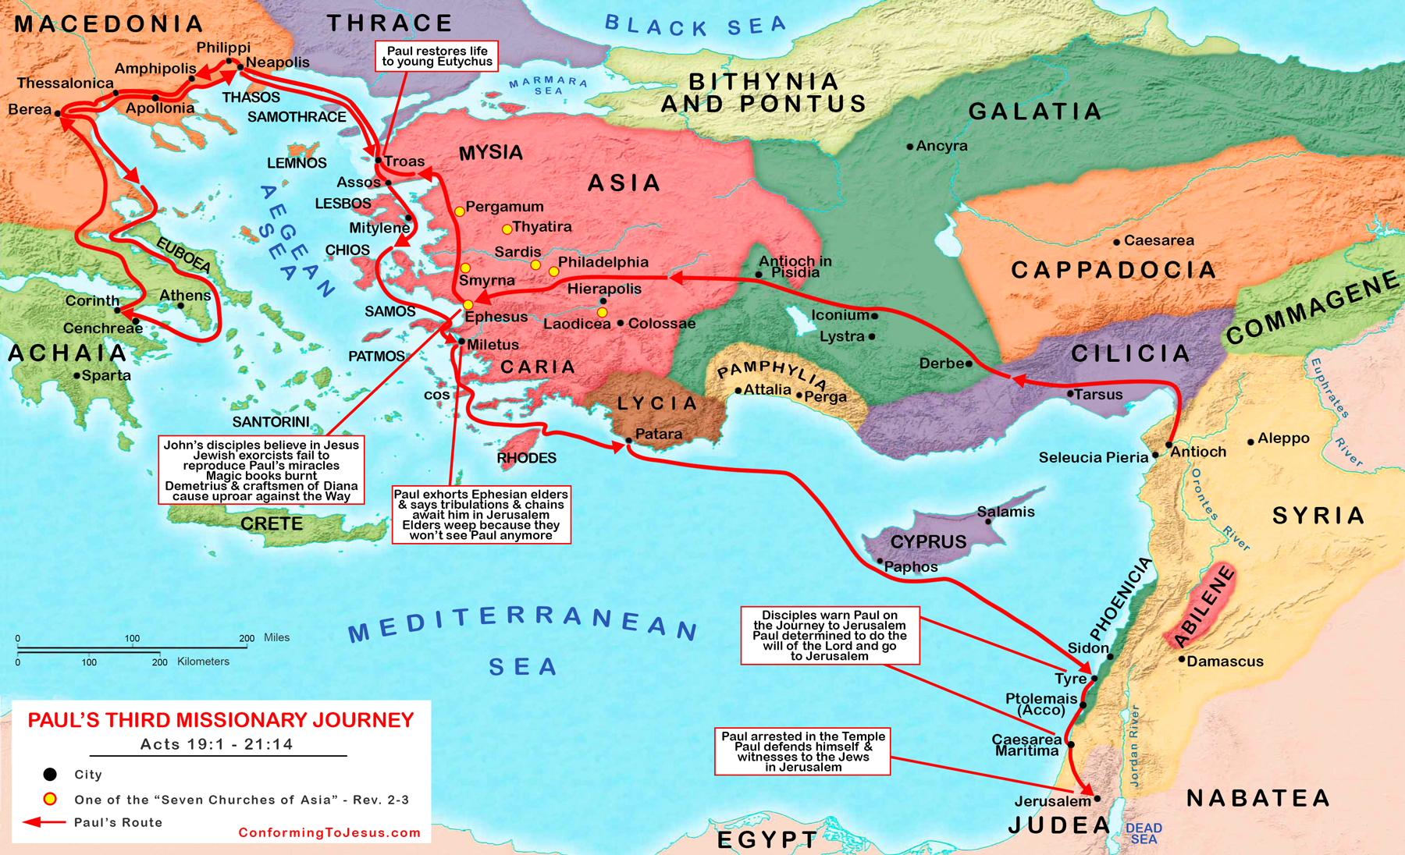
A
P

Slide 9
Paul At Ephesus 19:1-10
While Apollos was at Corinth, Paul came to Ephesus vv. 1-7
He found “disciples” of John, not of Jesus Christ v. 1b
– Obviously because of Apollos’ previous teaching 18:25
Paul questions them re: their reception of the Holy Spirit v. 2a
– His question is best understood in light of v. 6 and 8:16
They knew nothing of the Holy Spirit v. 2b
Paul follows up with a question about their baptism vv. 3-5
– He taught them the difference between the baptisms of John & Jesus
– Upon hearing this, they were baptized in the name of the Lord Jesus (the 1 and only N.T. baptism – Eph. 4:5)

Slide 10
Paul At Ephesus 19:1-10
While Apollos was at Corinth, Paul came to Ephesus vv. 1-7
He laid his hands upon them, and they began speaking in tongues and prophesying v. 6
The Ephesian church increased by 12 more souls v. 7
He spent the next 3 months speaking boldly in the synagogue v. 8
Some became hardened, disobedient, “speaking evil…” v. 9a
Paul withdrew with disciples to the school of Tyrannus v. 9b
This continued for 2 years… “all who lived in Asia heard” v. 10

Slide 11
“Points to Consider”
The possession of spiritual gifts was limited, even in the 1st century
Luke’s earlier record re: Samaria teaches people did not receive the Holy Spirit simply because they had been baptized Acts 8:16
For believers to possess the Holy Spirit (other than Cornelius – Acts 10) would have required the laying on of an apostle’s hands
With no apostles still alive today, there is no way one can possess spiritual gifts . A limited purpose/duration 1 Cor 13:8b-10

Slide 12
“Points to Consider”
Proper N.T. baptism
N.T. baptism must have 3 elements to be valid/scriptural:
If any one of these elements is incorrect, that baptism is not valid, and the one who submitted to it is not right with Lord
Anyone should carefully consider his/her baptism
REASON
MODE
P
P
Remission of sins
Immersion
Matt 3:1-6
Mk 1:4-5
Lk 3:3
Acts 19:4
Matt 3:16
Jn 3:23
O
NAME
John the Baptist
Acts 19:3
The Baptism Of Acts 19

Slide 13
“Applications”
Aquila & Priscilla’s efforts with Apollos
They took a public teacher aside privately, and explained the way of the Lord more accurately Acts 19:26
Because of later revelation, Priscilla also had to be mindful of her role… yet, she was involved in helping a man learn truth 1 Tim 2:12
Apollos also is to be commended for his apparent humble spirit, willing to be taught “more accurately” Rom 12:3 Prov 3:7
Let’s be like Aquila & Priscilla and Apollos when discussing God’s word

